Slide 1
Dynamic Programming
Approach
Yash N.C.
181210062

Slide 2
Dynamic Programming
Dynamic Programming is used in optimization problems. Dynamic Programming solves problems by combining the solutions of subproblems. Moreover, Dynamic Programming algorithm solves each sub-problem just once and then saves its answer in a table, thereby avoiding the work of re-computing the answer every time. Dynamic Programming is used when the subproblems are not independent, e.g. when they share the same subproblems.

Slide 3
How Dynamic Programming Works ?
Two main properties of a problem suggest that the given problem can be solved using Dynamic Programming.These properties are :
Overlapping sub - problems : When a recursive algorithm would visit the same subproblems repeatedly, then a problem has overlapping subproblems.
Optimal substructure : A given problem has Optimal Substructure Property, if the optimal solution of the given problem can be obtained using optimal solutions of its sub-problems.

Slide 4
How Dynamic Programming Works ?
Steps of Dynamic Programming Approach :
Characterize the structure of an optimal solution.
Recursively define the value of an optimal solution.
Compute the value of an optimal solution, typically in a bottom-up fashion.
Construct an optimal solution from the computed information.

Slide 5
How Dynamic Programming Works ?
Components of Dynamic programming :
Stages: The problem can be divided into several subproblems, which are called stages. A stage is a small portion of a given problem.
States: Each stage has several states associated with it. The states for the shortest path problem was the node reached.
Decision: At each stage, there can be multiple choices out of which one of the best decisions should be taken. The decision taken at every stage should be optimal; this is called a stage decision.
Optimal policy: It is a rule which determines the decision at each stage; a policy is called an optimal policy if it is globally optimal. This is known as Bellman principle of optimality.

Slide 6
Advantages
Reduces time complexity as it contains memory and fasten the process of execution
It has flexibility to allow application for other types of mathematical programming problems
Avoids multiple calculations due to previous stored values
Always finds the optimal Solution
Disadvantages
No general formation of Dynamic Program is available, every problem has to be solving in its own way.
Dividing problem in sub problem and storing intermediate results consumes memory.
Greater risk of error in run-time, slow execution speed in general.

Slide 7
Real Life Applications of Dynamic Programming
0/1 knapsack problem.
Mathematical optimization problem.
All pair Shortest path problem.
Reliability design problem.
Longest common subsequence (LCS)
Flight control and robotics control.
Matrix Chain Multiplication
Longest Common Subsequence
Travelling Salesman Problem

Slide 8
Matrix chain Multiplication (By Dynamic Programming)
Given a sequence of matrices, find the most efficient way to multiply these matrices together. The problem is not actually to perform the multiplications, but merely to decide in which order to perform the multiplications.

Slide 9
Matrix chain Multiplication
We have many options to multiply a chain of matrices because matrix multiplication is associative. In other words, no matter how we parenthesize the product, the result will be the same.The order in which we parenthesize the product affects the number of simple arithmetic operations needed to compute the product, or the efficiency.

Slide 10
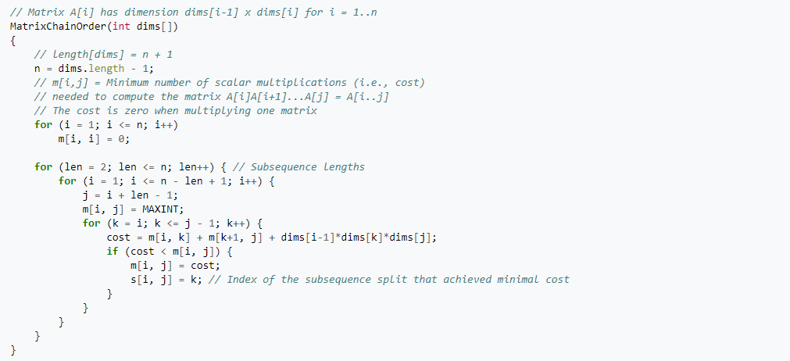
Matrix chain Multiplication (Algorithm)

Slide 11
Idea of Matrix chain Multiplication
The number of operations required to compute the product of matrices A1, A2... An depends on the order of matrix multiplications, hence on where parenthesis are put. The matrix product is associative, but not commutative, hence only the parenthesis can be moved.
The Matirx Chain Sequence problem is solved in following steps:
Take the sequence of matrices and separate it into two subsequences.
Find the minimum cost of multiplying out each subsequence.
Add these costs together, and add in the cost of multiplying the two result matrices.
Do this for each possible position at which the sequence of matrices can be split, and take the minimum over all of them.

Slide 12
Idea of solving Matrix chain Multiplication
Example :
A(5,6) B(6,3) C(3,1):
AB costs 5*6*3=90 and produces a matrix of dimensions (5,3), then (AB)C costs 5*3*1=15. The total cost is 105.
BC costs 6*3*1=18 and produces a matrix of dimensions (6,1), then A(BC) costs 5*6*1=30. The total cost is 48.
In this case, computing (AB)C requires more than twice as many operations as A(BC).

Slide 13
Why use Dynamic Programming For this problem?
Dynamic Programming is preferred for Matrix Chain Multiplication Problem as the program will have to store the values of the cost of multiplication of previous sequences to compare with the cost of other sequences. Each time we compute the minimum cost needed to multiply out a specific subsequence, we save it. If we are ever asked to compute it again, we simply give the saved answer, and do not recompute it. Since there are about (n^2)/2 different subsequences, where n is the number of matrices, the space required to do this is reasonable. It can be shown that this simple trick brings the runtime down to O(n^3) from O(2^n), which is way more efficient.

